Slide 1

Vulnerability Management Pipeline
A proactive approach to cybersecurity
Group 5
Tutor: Taysir Dyhoum
Photo by Pexels

Slide 2
Group Members
Lok Wing Lavin Wong (Team Leader, Coordinator, Editor, Review, Validator)
Akram Miah (Researcher & Editor)
Alexandre Dias Da Costa (Researcher & Editor, Validator)
Alexander Shore (Researcher, Review)
Sabir Ali (Researcher, Editor)
Arham Aslam (Not involved)

Slide 3
Objectives of this project
Lok Wing Lavin Wong
Introduction of vulnerability management pipeline
Components of the pipeline
Details of the pipeline workflow
Benefits
Challenges
Conclusion

Slide 4
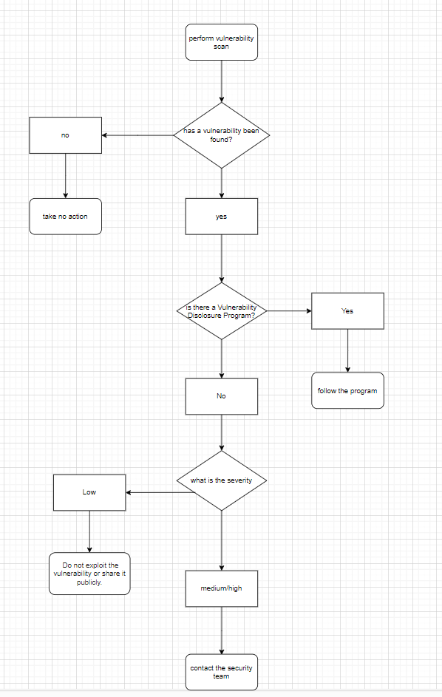
Initial Idea
Alexandre Dias Da Costa

Slide 5
Introduction
Lok Wing Lavin Wong
A vulnerability management pipeline is a systematic process used by organizations to identify, assess, prioritize, remediate, and mitigate security vulnerabilities within their systems and software applications.
Importance: Crucial component of cybersecurity strategy. Ensures proactive approach to security rather than reactive. Helps mitigate risks associated with cyber threats. Essential for maintaining the integrity and confidentiality of organizational data and assets.

Slide 6
Vulnerability Management Pipeline
Lok Wing Lavin Wong
Efficient Process
Potential Challenges
Clear process for reporting and triaging vulnerabilities
Dependence on human analysts for severity assessment could lead to errors
Detailed assessment helps in identifying root causes and potential solutions
Lack of automated tools for vulnerability identification and assessment
Effective tracking and management of vulnerabilities for timely resolution
Manual notification process for developers may cause delays in fixing vulnerabilities, leading to potential security risks

Slide 7
Vulnerability Triage
Lok Wing Lavin Wong
Efficiency & Clarity
Subjectivity & Resources
✔
Efficient assessment of severity and impact
✘
Risk of misclassification due to subjective criteria
✔
Clear categorization for prioritization
✘
Possible delays in assigning severity levels
✔
Detailed analysis for effective mitigation
✘
Resource-intensive process for large volume of reports

Slide 8



Asset Security
Lok Wing Lavin Wong
Regular Scans
Threat Intelligence
Vulnerability Assessment
Schedule routine scans to detect vulnerabilities on assets.
Stay updated on emerging threats through threat intelligence feeds.
Assess criticality and impact of vulnerabilities for prioritization. (Low/Medium/High)

Slide 9
Pipeline Example (Software-Internal)

Slide 10




Issue Tracking
Alexander Shore
Developer Notification
Developers receive detailed info about vulnerabilities for resolution.
Code Review
Code is reviewed and read through to ensure secure coding practices have been followed and there are no spottable mistakes/vulnerabilities. Code can also be passed through software which can scans and analyses for errors and vulnerabilities.
Vulnerability Reporting
Vulnerabilities are reported by users using a responsible disclosure policy via a designated email address providing vital information on where the vulnerability is what systems it affects and how to find it.
Vulnerability Triage
Security analysts assess the severity and potential impact of the reported vulnerabilities and prioritise them, so the most severe issue gets solved first and less severe issues are solved after. Aging is often applied which raises severity as time passes to avoid the issue being overlooked by higher risk issues this prevents low severity incidents from being ignored.

Slide 11
Code Review Best Practices
Akram Miah
Discussing code with team members helps to spot errors early this can be useful as it will allow for each team member to bring in their own set of skills and experiences. This allows for more improvement in code quality and new contributions
Collaboration
Constructive feedback leads to better code quality and understanding, this also means that you should focus more on the code and not the coder alongside this make sure to be as constructive as possible this will ensure that you can improve the code better
Feedback
Continuous improvement through code reviews enhances overall performance and this can be done by staying updated and constantly getting feedback on your code and then constantly learn and try to improve your code and doing this on a long enough time frame will lead to improvement in code
Improvement
Quality Assurance
Code reviews ensure adherence to coding standards and best practices and this can be done through automated tests, and this can be tools that can help you find any sort of issues in the code or performance testing, and this is testing the code and making sure that it works and testing the performance and quality

Slide 12

Quality Assurance
Sabir Ali
QA team ensures fix does not break existing functionality.
Test if users can still log in after the fix.
Create a test plan covering login regression tests.
Ensure the fix doesn't harm other functions like account management or password recovery.
Use automated tests to monitor login function for any future regressions.
Verification
Additional Testing
Quality assurance engineers play a crucial role in guaranteeing the dependability, efficiency, and honesty of the testing procedure, which ultimately enhances the overall standard of the product. QA engineers validate fixes across different environments.
Examining Test Plans and Test Cases
QA engineers carry out test cases in order to verify that the testing procedure are being carried out appropriately and that they are carried out in accordance with the established protocols and that the anticipated and actual findings match.
Examining Test findings
Regression testing

Slide 13
Pipeline Timeline
Reporting
Notification
Triage
Review

Slide 14
Release and Deployment (Quality Assurance)
Lok Wing Lavin Wong
Stakeholders are kept informed throughout the pipeline for transparency and accountability.
Security reports provide valuable insights into vulnerabilities and their resolution status.
QA team verifies successful mitigation of vulnerabilities without introducing new issues.

Slide 15



Vulnerability Management Pipeline (overall)
Lok Wing Lavin Wong
Regular Reviews
Identify areas for improvement
Response and Communication
Respond promptly to active threats
Continuous Improvement
Postmortem analyses of security incidents

Slide 16
Assessment Survey
Lok Wing Lavin Wong
Summary link https://forms.office.com/Pages/AnalysisPage.aspx?AnalyzerToken=ZL8li8HMmNnJ2Cws6BBwNqGFpg8gjyTv&id=UPs_KAujjEiQ9M2uT3rm0cwgoo8cQX5LiXKIHAAVjLhURDM3Tk1DS00xVTlLV0UyMkdGQzM2Q0pNRC4u

Slide 17
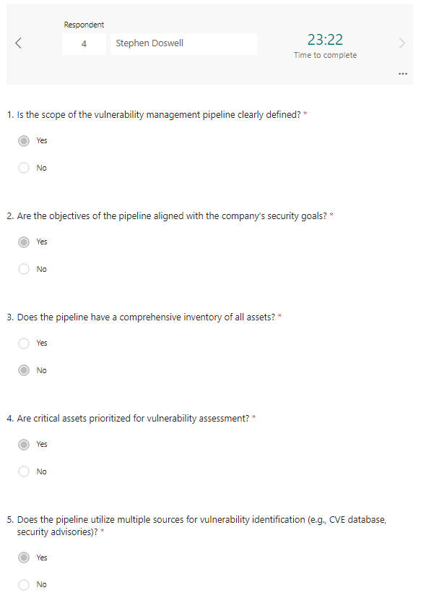
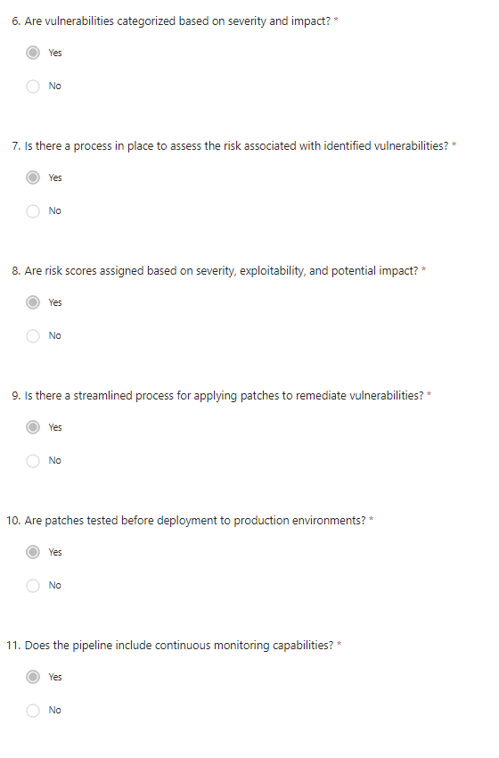
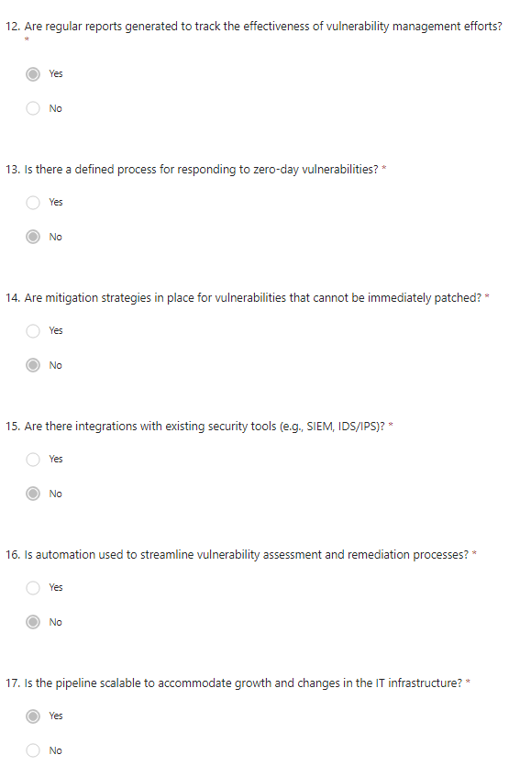
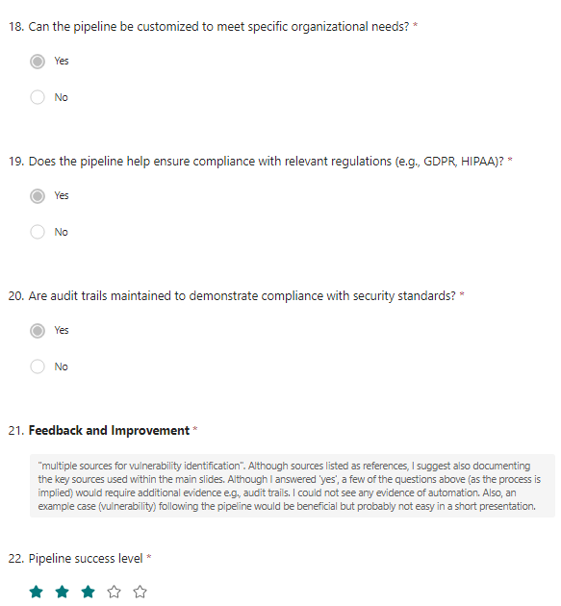
Assessment Survey (Done by the Cyber Security Expert)
Lok Wing Lavin Wong

Slide 18
Assessment Survey (Feedback by the Cyber Security Expert)

Slide 19
Reference
Lok Wing Lavin Wong
What is Vulnerability Management? - Aqua Security
How To Build An Effective Vulnerability Management Program (purplesec.us)
https://resources.infosecinstitute.com/topics/vulnerabilities/how-to-report-a-security-vulnerability-to-an-organization/
https://theqalead.com/test-management/vulnerability-management-process/#:~:text=As%20a%20process%2C%20vulnerability%20management,resolving%20the%20uncovered%20threats%20satisfactorily.
https://blog.gitguardian.com/key-highlights-from-the-new-nist-ssdf/

